Slide 1


Slide 2
What is computerized medical records ?
Computerized medical record (CMR): This is a generic term, similar to digital medical record, which implies that this is a record under the custodianship of a medical or health care provider, and is inclusive of partial and complete records.
The objectives of a successful computerized record system, include:
(1) a demonstrated superiority to the current record systems in ease of clinical use while providing pertinent and complete information, and while recording important and unexpected complications or physiologic processes;
(2) the capability of improving the decision making processes in clinical medicine by simplifying analysis of relevant clinical data;
(3) the provision of a model for monitoring the quality of medical care; and
(4) on-line availability of the data at any time for clinical use and interpretation.

Slide 3
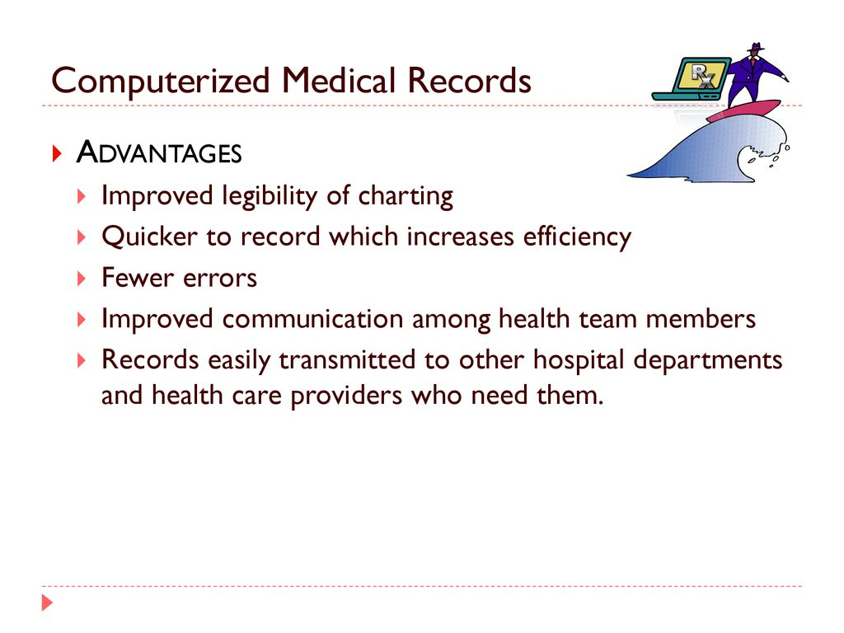
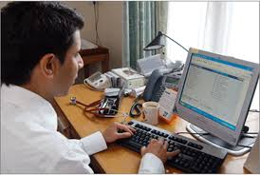

Slide 4
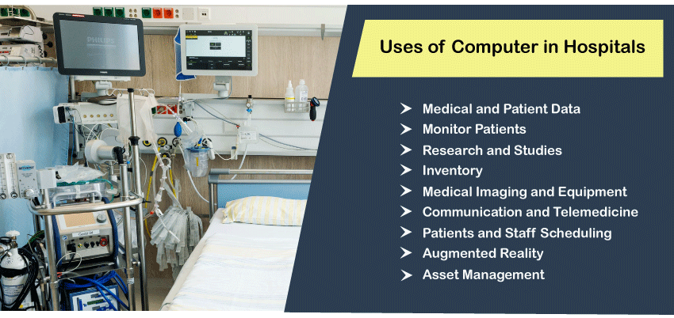
In hospitals, computers are used for multiple tasks such as maintaining the information of patients, records, live monitoring of patients, X-rays, and many more. In hospitals, computers are also helpful to configure lab-tools, monitoring the blood pressure and heart rate, etc.

Slide 5
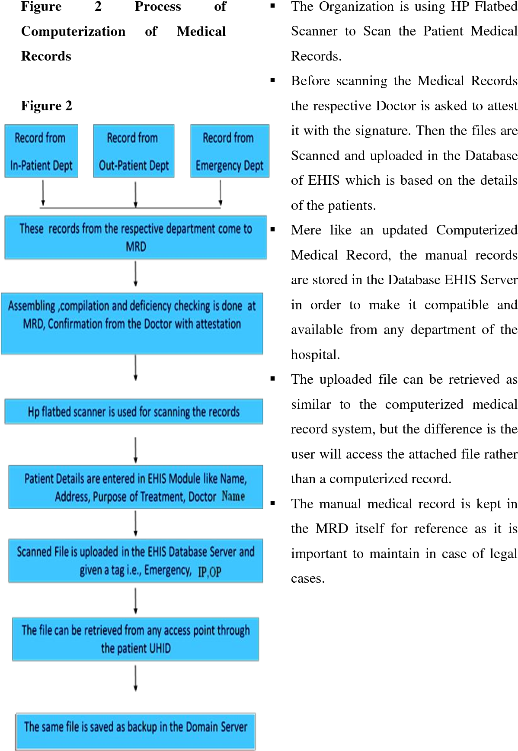
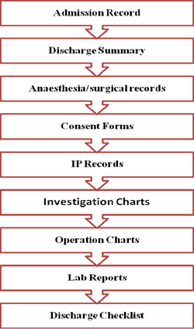
PROCESS

Slide 6
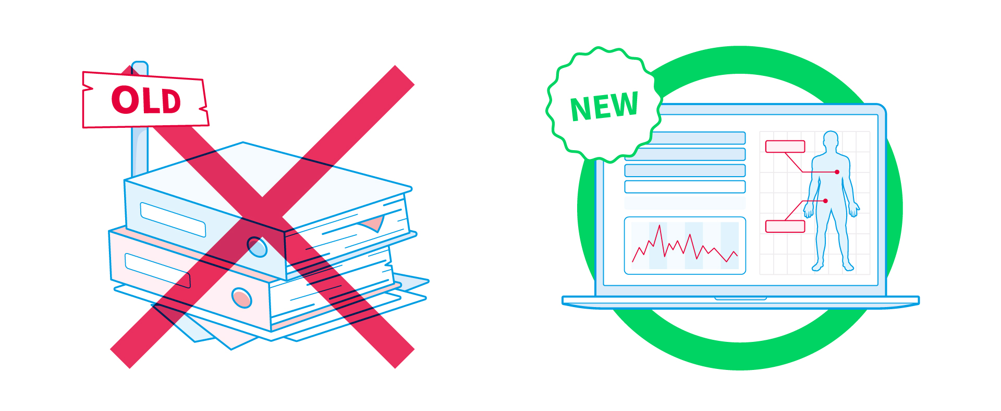
What are EHR and EHR Systems?
It is software for a structural way of storing and sharing patient data. EHRs are digital versions of paper patient cards, real-time and patient-oriented records that make information instantly secure and accessible for users who have authorized them.
This facilitates collaborative working practices where different health professionals can work together in real-time to provide patients with the best care. Also, it enables quick access to services, which will improve waiting lists and diagnosis accuracy using the most advanced EHR measures.
The goal of any EHR system is to create a comprehensive, accurate healthcare history for a patient.

Slide 7
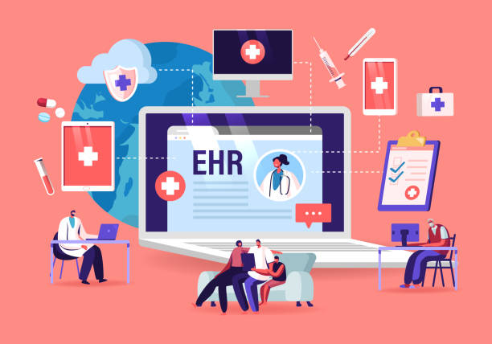
EHRs and the ability to exchange health information electronically can help you provide higher quality and safer care for patients while creating tangible enhancements for your organization. EHRs help providers better manage care for patients and provide better health care by:
Providing accurate, up-to-date, and complete information about patients at the point of care.
Enabling quick access to patient records for more coordinated, efficient care
Securely sharing electronic information with patients and other clinicians
Helping providers more effectively diagnose patients, reduce medical errors, and provide safer care

Slide 8
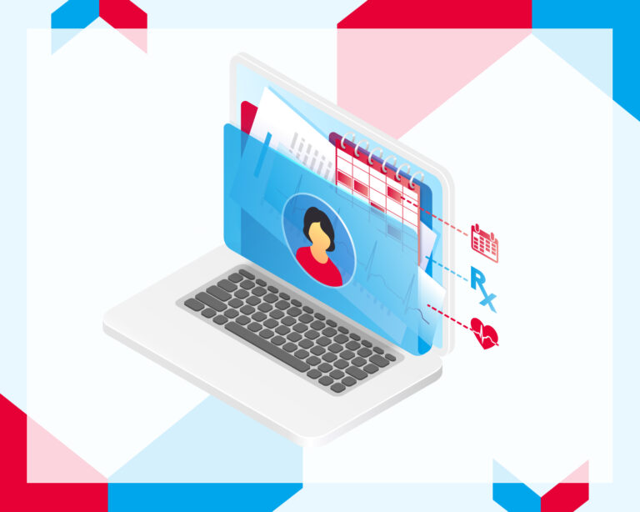
Improving patient and provider interaction and communication, as well as health care convenience
Enabling safer, more reliable prescribing
Helping promote legible, complete documentation and accurate, streamlined coding and billing
Enhancing privacy and security of patient data
Helping providers improve productivity and work-life balance
Enabling providers to improve efficiency and meet their business goals
Reducing costs through decreased paperwork, improved safety, reduced duplication of testing, and improved health.

Slide 9
EHR ADVANTAGES
The benefits of electronic health records include:
Better health care by improving all aspects of patient care, including safety, effectiveness, patient-centeredness, communication, education, timeliness, efficiency, and equity.
Better health by encouraging healthier lifestyles in the entire population, including increased physical activity, better nutrition, avoidance of behavioral risks, and wider use of preventative care.
Improved efficiencies and lower health care costs by promoting preventative medicine and improved coordination of health care services, as well as by reducing waste and redundant tests.
Better clinical decision making by integrating patient information from multiple sources.
EHR DISADVANTAGES
Outdated data. EHRs can get incorrect information if the EHR is not updated immediately when new information, such as when new test results come in. ...
It takes time and costs money. Selecting and setting up an EHR system and digitizing all paper records can take years. ...
Inconsistency and inefficiency.

Slide 10
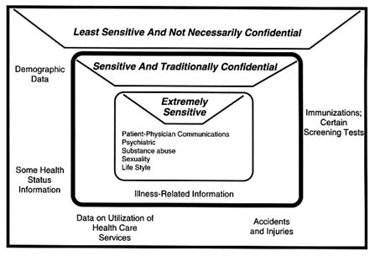
There are also several disadvantages of electronic medical records, such as:
Potential Privacy and Security Issues: As with just about every computer network these days, EHR systems are vulnerable to hacking, which means sensitive patient data could fall into the wrong hands
Cybersecurity risks. Risk related to breach of protected health information.
Impersonal patient-doctor interaction / patient isolation. Patients interact with technology instead of a live care provider. ...
Frustration with poor implementation.

Slide 11
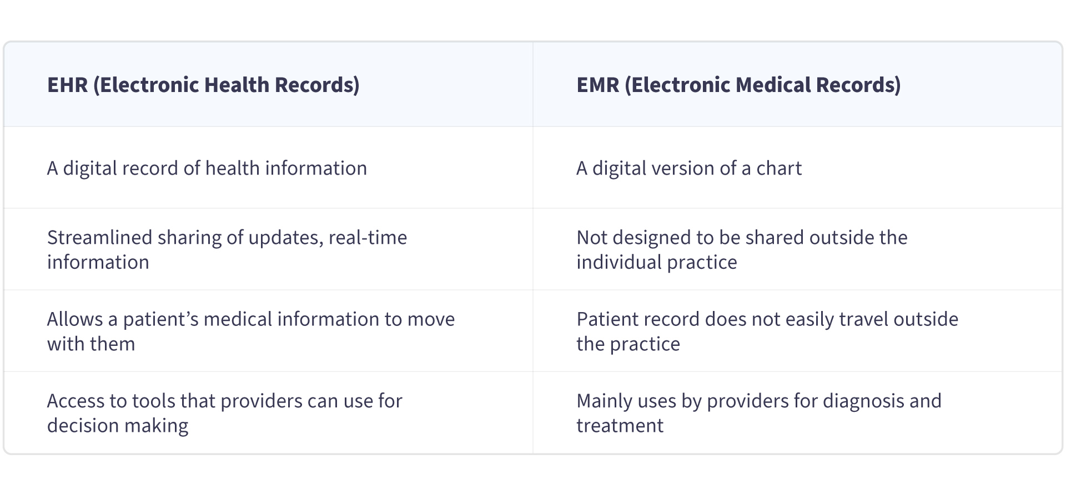
EMR vs. EHR The terms EMR and EHR are often used interchangeably, but this is fundamentally wrong. An EMR is a digital patient record from a single provider or clinic. The EMR system is designed to store medical information locally and is not intended for distribution outside of an individual’s practice.

Slide 12
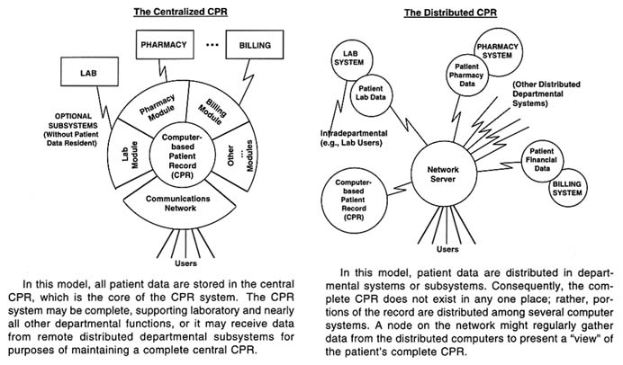

Slide 13
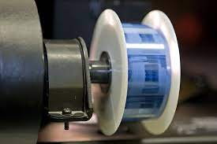
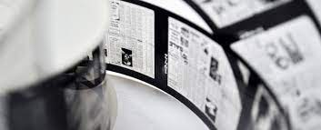
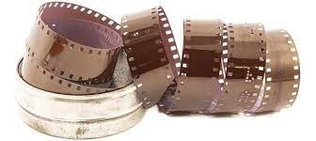
Microfilming of Medical Records

Slide 14
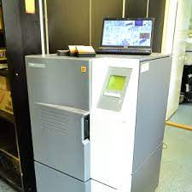
What is microfilming in medical records?
Microcopy, or microfilm, the legal status of which as record copy usually has had to be determined by special legislation, is a practical medium for making additional copies of records as security against risk through acts of warfare; as preservation against normal deterioration or damage;
Microfilm is exactly as it sounds; it is images of documents that have been made microscopic.
Microfilm can take entire newspapers and place them on a few 4X5 inch sheets.
This is identical to photography, which is also considered microfilm, just in larger size.
Film uses technology to imprint images of people, places, and things onto small rolls to be made into pictures later.

Slide 15
Advantages
Storage - Microfilm takes up very little space, which allows for a mass amount of records to be stored with very little effort.
Durability - If stored properly, microfilm can last hundreds of years, unlike its paper counterpart.
Price - Although, a microfilm reader is necessary, it has a minimal price tag versus computers, hard drives, and online memory.
Disadvantages
The retrieval rate is slow, its very hard to update, and
Only one person at a time can see the images covered by the roll of film.

Slide 16
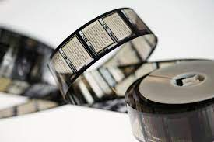
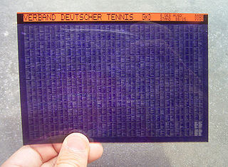
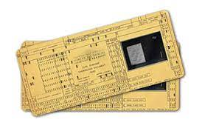
Types of Microfilm
Roll Film - This is film that sits on a reel and comes in 16 millimeter and 35millimeter formats. This microfilm has been used by photographers and movie makers alike.
Microfiche - Microfiche comes in two different varieties, COM and Jacket. COM fiche is the image seen here. This is the standard microfiche used in libraries. The images are placed in a gridded fashion. COM fiche can hold up to 300 pages of information/images. Jacket fiche is more used for camera film. The film is usually 5 images across and placed in plastic jackets.
Aperture Cards - These cards look like old timecards, but they have a square hole cut out, where the film resides. The cards only hold one image, while the rest of the card contains information about the image. These cards are used more in engineering than in any other field..
Storage and Equipment
Each type of microfilm requires different storage, which is why it is important for records management that one type of microfilm is used, not a variety.
, But it should be ensured that the sealed containers are placed within metal cabinets that have been treated with the right paint (non-corrosive, non-staining and non-combustible). This helps protect the microfilm from damage via corrosion, fire, and more

Slide 17
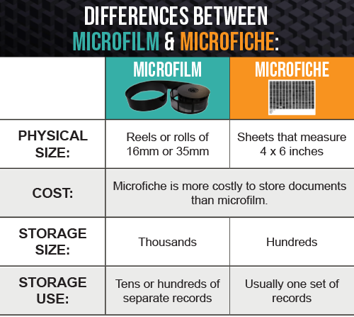

Slide 18
Microfilm Can Deteriorate And Decay
If storing or using microfilm, you should make sure you’re storing it properly so that you get the longest use possible out of it. Microfilm can and will start to deteriorate if it’s not maintained in the right way.
Many things contribute to microfilm decay, and the most prevalent are poor storage conditions and heavy use.
Poor storage includes hot and humid temperatures where the microfilm is located, leaving the film exposed to light, and keeping the film in areas where other chemicals exist (such as a storage room with paint, for example).
Using the microfilm can’t really be stopped, because that’s the point of having the information available. But if your organization uses the film regularly, or if you have customers that use it (like at a library), keep an eye on its condition and consider creating a duplicate backup copy or digitizing your collection.
Microfilm Can Be Converted Into Digital Images
Like paper files, microfilm can be scanned and converted into digital images. With the many benefits that microfilm provides, having a digital copy of your data can be extremely useful. By digitizing your microfilm, you can have faster and easier access to the records; increased security by adding permission-based access to the images and data

Slide 19
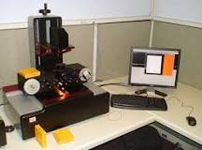
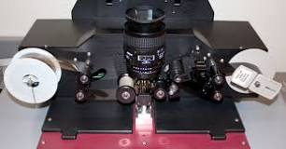
How microfilm is created?
All regular microfilm copying involves contact exposure under pressure. Then the film is processed to provide a permanent image. Hand copying of a single fiche or aperture card involves exposure over a light box and then individually processing the film.
How to digitize microfilm?
To digitize a roll of microfilm, it must first be installed on the flexScan machine. The film has to be woven through precisely, as shown here: Then, the digitizer adjusts several settings on a computer connected to the flexScan. These include the width of the film (16 or 35 mm) and polarity (negative or positive.

Slide 20
